Slide 1
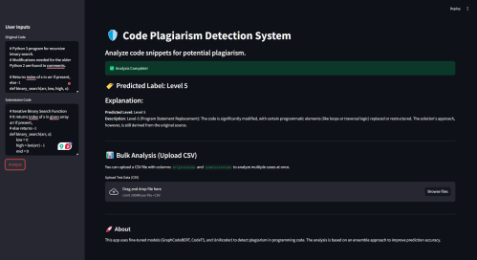
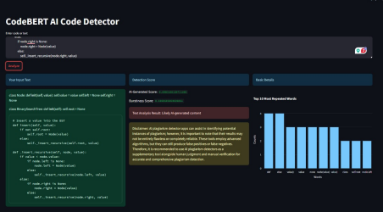
AIS411
Leveraging Fine-Tuned Ensemble Models for Multi-Class Code Plagiarism and AI Code Detection
Team: Youssef Hawary, Omar Morshdy, Ahmed Kamal, Mohamed Abdelnaser
Keywords
Multimodal learning, Image ranking, Sentence-to-image relevance
Idiomatic expressions, Visual-textual alignment, Similarity scoring
Visual storytelling, Sequential reasoning
Story-driven image selection, Contextual image ranking
The experiments utilize specific datasets for both plagiarism levels and AI code detection, with evaluation metrics centered on accuracy. The experiments are conducted on Google Colab Pro with an NVIDIA GPU, facilitating efficient model inference and training.Overall, this methodology integrates sophisticated model training, ensemble techniques, and innovative prompt engineering to address critical issues in software development ethics.
Abstract
The paper addresses the significant challenges in detecting code plagiarism and AI-generated code, complicated by structural transformations and logical refactorings. It proposes a Dual Fine-Tuned Ensemble model combining GraphCodeBERT, CodeT5, and UniXcoder, which achieves a notable accuracy of 88% in plagiarism detection and 83% in AI code detection. The models are deployed via a user-friendly Streamlit interface, enhancing code integrity analysis and maintaining academic ethics effectively.
Results
The ensemble model integrates outputs from UniXcoder, GraphCodeBERT, and CodeT5, providing class predictions across seven plagiarism levels (Non-Plagiarized, L1-L6).
The models' probabilities are summed and normalized using a softmax function to determine the most likely class. In a sample case, the highest probability indicated Level 5 (Logic Change) plagiarism, highlighting the framework's efficacy with an 88% accuracy rate, particularly for complex code transformations.
Introduction
There are challenges in programming ethics and code originality that have emerged with rapid software development, particularly in academic and professional settings. These include detecting plagiarism and differentiating human-written code from AI-generated content. Traditional methods struggle with heavily altered code due to their reliance on text-based similarity measures. To combat these issues, the introduction proposes a novel framework featuring two main components:Plagiarism Detection: This employs a Dual Fine-Tuned Ensemble model comprising GraphCodeBERT, CodeT5, and UniXcoder, trained on the same dataset to detect various levels of code transformation. The system boasts an 88% accuracy rate, significantly improving upon existing tools.AI-generated Code Detection: Utilizes CodeBERT with few-shot learning to distinguish between AI-generated and manually written code, emphasizing the importance of strategic prompt design to enhance accuracy.The framework integrates these components into interactive Streamlit interfaces, facilitating decision-based analysis by educators, developers, and software integrity auditors. Experimental results show the framework's effectiveness in addressing real-world challenges and advancing ethical software development practices.
Methodology
presents a two-pronged methodology aimed at addressing challenges in code originality and ethics through the Plagiarism Detection Framework and the AI Code Detection Framework, both utilizing advanced transformer models and engineering techniques.
Plagiarism Detection Framework: Combines three transformer-based models—UniXcoder, GraphCodeBERT, and CodeT5—each fine-tuned to classify code based on similarity to the original source. These models analyze code transformations ranging from exact matches to substantial alterations, and their outputs are aggregated using an ensemble method to determine the final classification, aiming to enhance accuracy in detecting various levels of plagiarism.
AI Code Detection Framework: Focuses on distinguishing between human-written and AI-generated code. This framework employs CodeBERT, fine-tuned on a dataset comprising both types of code, to effectively identify AI-generated code. LangChain is integrated for dynamic prompt engineering, enhancing the model’s classification accuracy through few-shot learning.
Deployment and Experiments: The frameworks are deployed via Streamlit, offering an interactive platform for users to upload code for plagiarism checks or AI origin detection
Conclusion And Future Work
The dual fine-tuned ensemble model successfully addresses complex challenges in detecting code plagiarism and AI-generated code with high accuracy using advanced transformer technologies.
Future enhancements will focus on expanding the dataset variety, improving AI code detection, optimizing model efficiency, enhancing the user interface, and employing semi-supervised learning to better adapt to evolving demands in software ethics and education.
Enhance the workflow of the plagiarism detection to get more than 30 file of code and find the plagiarized one among all
References
[1] J. Smith et al., ”Machine Learning for Source Code Similarity,” Journal of Computer Science, vol. 25, no. 3, 2022.
[2] L. Brown and K. Green, ”Graph-Based Representations for Code Plagiarism Detection,” ACM Computing Surveys, vol. 54, no. 2, 2023.
[3] R. Lee et al., ”Code Stylometry for Plagiarism Detection,” IEEE Transactions on Software Engineering, 2023.

